Slide 1

CVR COLLEGE OF ENGINEERING An UGC Autonomous Institution, Affiliated to JNTUH, Accredited by NBA, and NAAC) Vastunagar, Mangalpalli (V), Ibrahimpatnam (M), Ranga Reddy (Dist.) - 501510, Telangana State
Minor Programme – Mini Project
Seminar-II
on
Securing the Web through the analysis of Phishing URL using Machine Learning Algorithms
by
P. Sowmith Reddy (20B81A05P0)
Balguri Vaishnavi (20B81A05V5)
Under guidance of
Ms. M. Sumalatha
Assistant Professor

Slide 2
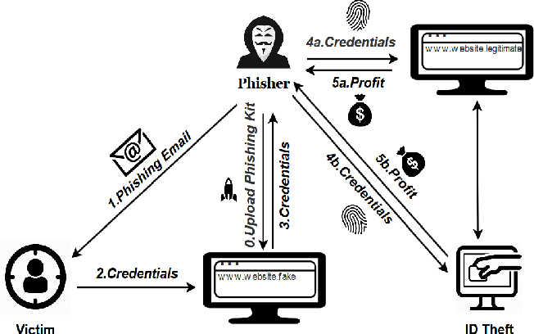
INTRODUCTION
Phishing is a fraudulent attempt to obtain sensitive information or data by impersonating oneself as a trustworthy entity in a digital communication, causing financial losses.
Phishing messages come in different shapes such as email, sms, and website links, all of which are designed to look genuine and use the same format as the legitimate company.

Slide 3
CHALLENGES AND PROBLEM STATEMENT
Phishing attacks pose a serious threat, exploiting evolving tactics to compromise data and cause financial losses.
Current cybersecurity measures fall short, necessitating advanced detection systems that leverage cutting-edge technologies, such as machine learning models, to effectively identify and mitigate phishing threats.
The challenge is to build the comprehensive phishing detection system using accurate machine learning model.

Slide 4
EXISTING METHODLOGIES
S. No. | Author(s) and Year | Title | Scope | Limitations
1. | Y. Cao, W. Han, and Y. Le - 2018 | Anti-phishing based on automated individual white-list | Phishing detection systems use whitelists for safe sites and blacklists for phishing sites. Whitelist allows access based on inclusion, while blacklist denies based on exclusion. | Vulnerability to URL Modifications. Ineffectiveness against Zero-Day Attacks.
2. | L. Wenyin, G. Huang, L. Xiaoyue, Z. Min, and X. Deng - 2017 | Detection of phishing webpages based on visual similarity | Visual similarity-based phishing detection systems assess web pages using server-side image processing techniques to compare features of phishing and non-phishing sites. They play a crucial role in identifying subtle visual distinctions between fake and legitimate websites | Difficulty in accurately identifying subtle visual differences. Potential for false positives or negatives. Challenges with complex web page designs.

Slide 5
PROPOSED SOLUTION
This project aims to enhance internet security by creating a comprehensive phishing detection system by employing various machine learning models.
After rigorous testing, the model with the highest accuracy is integrated into a user-friendly GUI, allowing individuals to predict whether a given URL is phishing or legitimate, accompanied by a confidence percentage.
Addressing limitations in traditional methods like List Based Phishing Detection Systems and Visual Similarity-Based Phishing Detection Systems, our approach, with improved accuracy and an intuitive interface, outperforms existing models.

Slide 6
TECHNOLOGY STACK
SOFTWARE REQUIREMENTS
HARDWARE REQUIREMENTS
Operating System - Windows, MacOS or Linux
Programming Language - Python 3.11.2
Execution Environment - Jupyter Notebook or Visual Studio Code
Web Framework - Flask or Tkinter
Machine Learning Libraries - Scikit-Learn, Pandas, Numpy
RAM - 8 GB or above
Processor - Intel core i5 with 11th gen or above
Storage - 256 GB SSD or above
Stable network connection

Slide 7
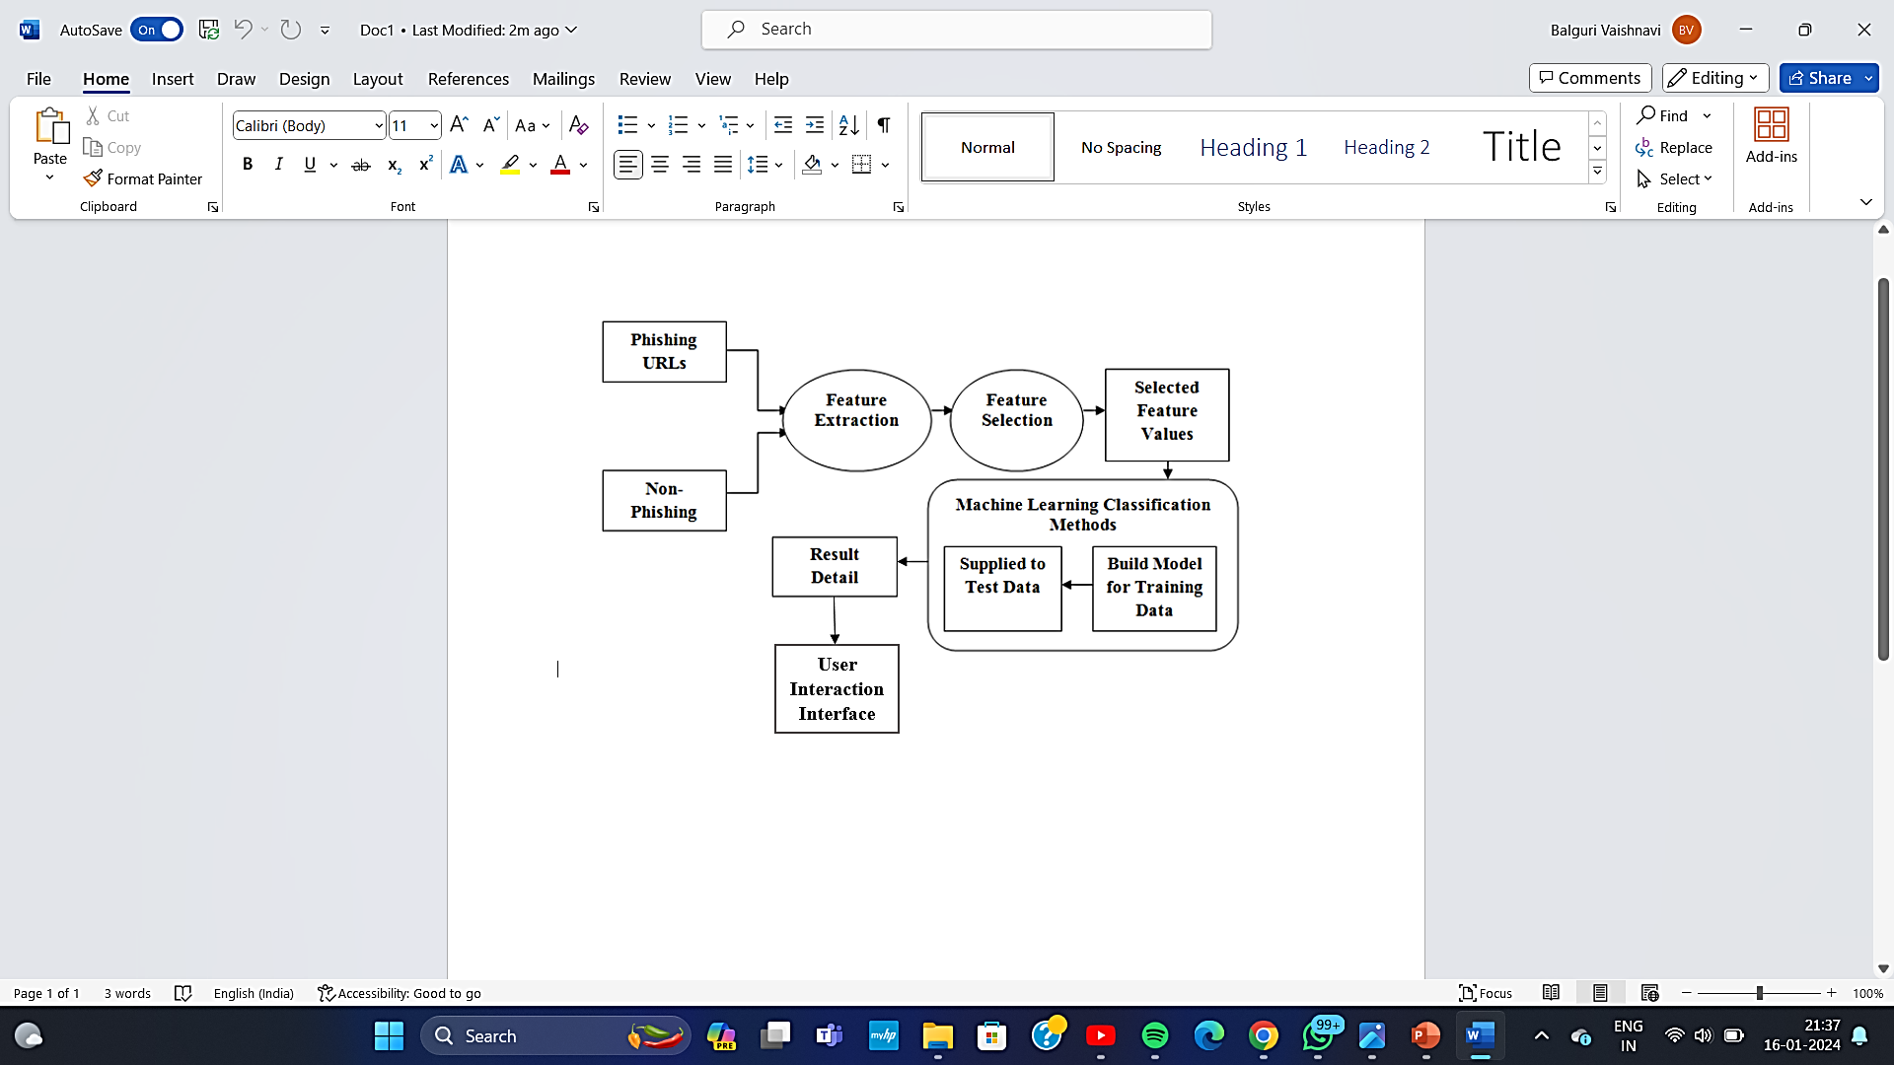
SYSTEM ARCHITECTURE DIAGARM

Slide 8
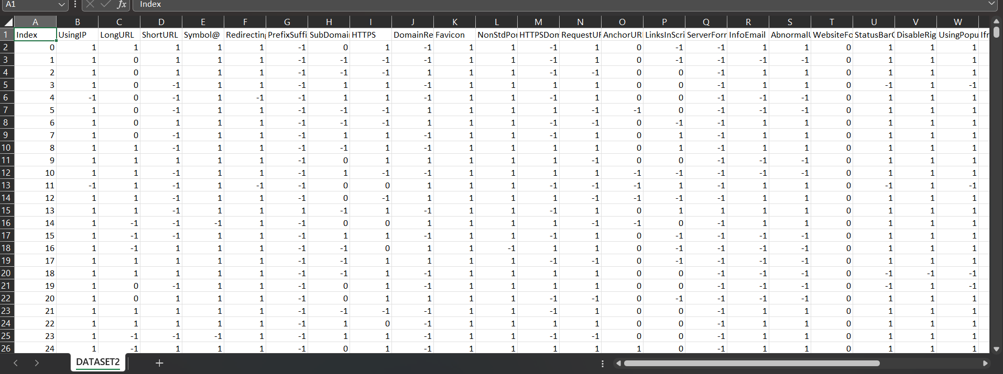
Feature Extraction

Slide 9
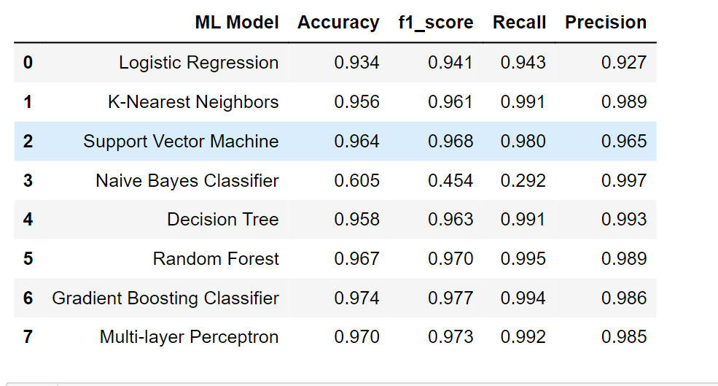
Machine Learning Model Evaluation

Slide 10
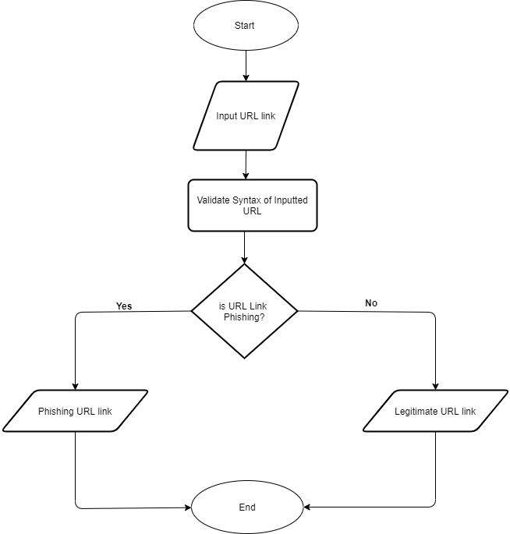
Flowchart Of GUI Application

Slide 11

User Interface Implementation

Slide 12
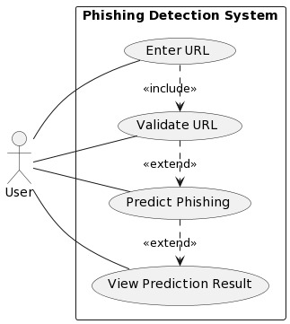
USE CASE DIAGRAM

Slide 13
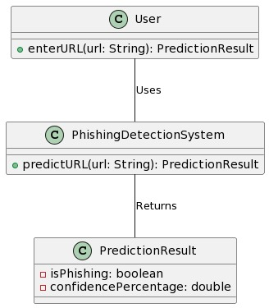
CLASS DIAGRAM

Slide 14
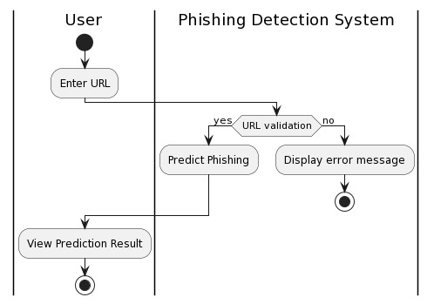
ACTIVITY DIAGRAM

Slide 15
CONTRIBUTION OF STUDENTS
Student Name: P. Sowmith Reddy
Contribution:
Research: Conducted comprehensive research on phishing website detection methods and algorithms.
Development: Implemented machine learning models and algorithms, focusing on feature engineering.
Testing: Assisted in testing the system and analyzing the performance of the models.

Slide 16
CONTRIBUTION OF STUDENTS
Student Name: B. Vaishnavi Reddy
Contribution:
Data Collection: Gathered and curated the dataset required for training and testing.
Development: Contributed to system architecture design and algorithm implementation.
Documentation: Responsible for documenting project progress and preparing project reports.

Slide 17
REFERENCES
[1] S. Parekh, D. Parikh, S. Kotak and P. S. Sankhe, ”A New Method for Detection of Phishing Websites: URL Detection,” 2018 Second International Conference on Inventive Communication and Computational Technologies (ICICCT), Coimbatore, 2018, pp. 949- 952.doi:10.1109/ICICCT.2018.8473085.
[2] Y. Cao, W. Han, and Y. Le, “Anti-phishing based on automated individual white-list,” Proceedings of the 4th ACM workshop on Digital identity management - DIM 08, pp. 51–60, 2018.
[3] L. Wenyin, G. Huang, L. Xiaoyue, Z. Min, and X. Deng, “Detection of phishing webpages based on visual similarity,” Special interest tracks and posters of the 14th international conference on World Wide Web - WWW 05, pp. 1060-1061, 2015.

Slide 18


